Slide 1


Language Integration
COM Programming
Notes:
Page <number>
WNCOMPG-2 v1.5
Chapter 9, Language Integration

Slide 2


Chapter Overview
Objectives
  Use wrapper classes to simplify C++ COM clients
  Access COM objects from Visual Basic, VBScript and Java
Chapter content
  Type libraries
  Early binding versus late binding
  Simple VB clients
  Importing a type library into a C++ client
  Using smart pointers
  Error handling
  Supporting rich error information
Practical content
  Generating and handling errors
Summary
Notes:
Page <number>
WNCOMPG-2 v1.5
Chapter 9, Language Integration

Slide 3


Using Type Libraries
Type libraries are the key to integrating COM servers and clients written in different languages
  Binary tokenised form of IDL
  Normally embedded as a resource in COM server DLL
Many types of clients can use them
  Visual Basic, Visual C++, Delphi, etc.
Others absolutely depend on them
  Visual J++, JavaScript and VBScript
Notes:
Page <number>
WNCOMPG-2 v1.5
Chapter 9, Language Integration

Slide 4
Visual Basic Clients
If type library is provided:
  Client can use any described interface - either through vtable or via IDispatch
  Client can use either late or early binding
If type library is not provided:
  Client can use only late binding - via IDispatch:GetTypeInfo() and IDispatch::GetIDsOfNames()
Notes:
Page <number>
WNCOMPG-2 v1.5
Chapter 9, Language Integration

Slide 5
Early Binding vs. Late Binding
Early binding
  Visual Basic IDE needs to consult type library at compile time
    Use Project->References dialog to make type library available
    Declare object variable of specific class
    Faster execution than late binding
Late binding
  Compiled code gets type information at run time via IDispatch
    Component must expose an IDispatch (or dual) interface
    Declare variable of type Object
    Slower execution than early binding and no type checking
Dim acc As SIMPLEACCOUNTLib.Account
Set acc = CreateObject("SimpleAccount.Account")
Dim acc As Object
Set acc = CreateObject("SimpleAccount.Account")
Notes:
Page <number>
WNCOMPG-2 v1.5
Chapter 9, Language Integration

Slide 6
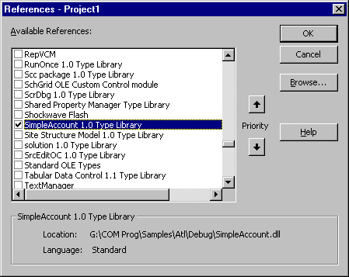
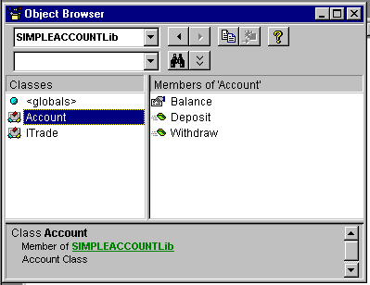
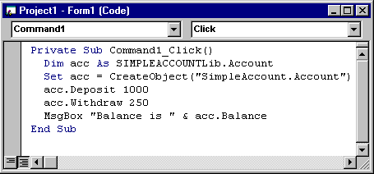
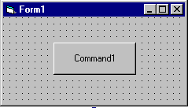

A Simple Early Binding VB Client
Notes:
Page <number>
WNCOMPG-2 v1.5
Chapter 9, Language Integration

Slide 7
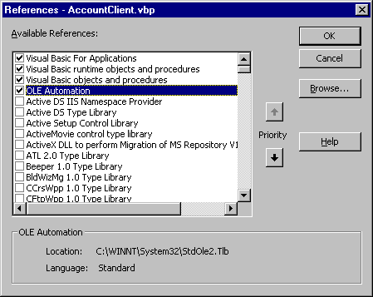
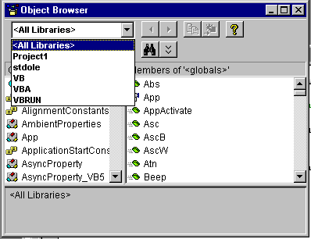
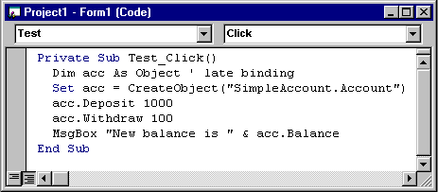
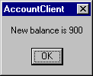
A Simple Late Binding Client
Notes:
Page <number>
WNCOMPG-2 v1.5
Chapter 9, Language Integration

Slide 8
A Closer Look at CreateObject()
This Visual Basic code is equivalent to the following C++ code
Uninitialised object variable
Type library name
Class name
Dim acc As SIMPLEACCOUNTLib.Account
Set acc = CreateObject("SimpleAccount.Account")
...
Reference to default interface,
IAccount, of Account object
Version-independent ProgID
IUnknown *obj = 0;
IAccount *acc = 0;
CLSID clsid;
CLSIDFromProgID("SimpleAccount.Account", &clsid);
CoCreateInstance(clsid, 0, CLSCTX_SERVER
IID_IUnknown, (void**)&obj);
obj->QueryInterface(IID_IAccount,(void**)&acc);
...
Notes:
Page <number>
WNCOMPG-2 v1.5
Chapter 9, Language Integration

Slide 9
Accessing Another Interface
Declare variable of interface type and set it to point to object
Call methods of second interface through new variable
Creates object of type Account
Returns reference to default interface, IAccount
Dim acc As SIMPLEACCOUNTLib.Account
Set acc = CreateObject("SimpleAccount.Account")
acc.deposit 1000
...
...
Dim itrade As SIMPLEACCOUNTLib.ITrade
Set itrade = acc
...
Declares variable of type ITrade
Obtains reference to ITrade interface
(calls acc.QueryInterface (...))
MsgBox "Buy price is " & itrade.BuyPrice
itrade.Buy 5
...
MsgBox "New balance is " & acc.Balance
Set itrade = Nothing
...
Releases reference to ITrade interface
Notes:
Page <number>
WNCOMPG-2 v1.5
Chapter 9, Language Integration

Slide 10
A Simple VBScript Client
Components that support IDispatch can also be called by scripting-language clients
  Specify CLSID in OBJECT tag of HTML document
  Can also produce a script for Windows Scripting Host (WSH)
AccountClient.html
<OBJECT ID="acc"
CLASSID="CLSID:81B8FDDD-FB37-11D2-9C81-000000000000">
</OBJECT>
<SCRIPT LANGUAGE="VBScript">
acc.Deposit 1000
acc.Withdraw 50
Document.Write "Current balance is " & acc.Balance
</SCRIPT>
AccountClient.vbs
Dim acc
Set acc = CreateObject("SimpleAccount.Account")
acc.Deposit 1000
acc.Withdraw 50
MsgBox "New balance is " & acc.Balance
Notes:
Page <number>
WNCOMPG-2 v1.5
Chapter 9, Language Integration

Slide 11
Simplifying a Visual C++ Client
Use #import directive to "import" type library from .tlb, .dll, .ocx or .exe file
Compiler generates two "header" files that contain
  A wrapper for each interface function ...
    Allows property methods to be accessed as member variables
    Directly return [retval] parameters
    Throw com_error exceptions instead of returning HRESULTs
  … plus a number of wrapper classes
    Allow _variant_t and _bstr_t types to be used instead of VARIANTs and BSTRs
  … plus a smart pointer for each interface pointer
    Based on _com_ptr_t<> template class
    Automatically make calls to CoCreateInstance()
    Responsible for all of IUnknown functionality
Notes:
Page <number>
WNCOMPG-2 v1.5
Chapter 9, Language Integration

Slide 12
Primary Header File (1)
Contains definitions for
wrapper classes
Associates a GUID with IAccount, which
can be retrieved using __uuidof()
SimpleAccount.tlh
#include <comdef.h>
namespace SIMPLEACCOUNTLib {
// Forward references and typedefs
struct /* coclass */ Account;
struct __declspec(uuid("81b8fddc-fb37-11d2-9c81-000000000000"))
/* dual interface */ IAccount;
// Smart pointer typedef declarations
_COM_SMARTPTR_TYPEDEF(IAccount, __uuidof(IAccount));
// continued on next slide
...
Expanded by compiler to:
typedef _com_ptr_t<_com_IID<IAccount, __uuidof(IAccount)> > IAccountPtr;
which defines a new smart-pointer class called IAccountPtr
Notes:
Page <number>
WNCOMPG-2 v1.5
Chapter 9, Language Integration

Slide 13
Primary Header File (2)
SimpleAccount.tlh
...
// Type library items
struct __declspec(uuid("81b8fddd-fb37-11d2-9c81-000000000000"))
Account;
// [ default ] interface IAccount
struct __declspec(uuid("81b8fddc-fb37-11d2-9c81-000000000000"))
IAccount : IDispatch {
// Property data
__declspec(property(get=GetBalance)) float Balance;
// Wrapper methods for error handling
HRESULT Deposit ( float amount );
HRESULT Withdraw ( float amount );
float GetBalance ( );
// Raw methods provided by interface
virtual HRESULT __stdcall raw_Deposit ( float amount ) = 0;
virtual HRESULT __stdcall raw_Withdraw ( float amount ) = 0;
virtual HRESULT __stdcall get_Balance ( float * pVal ) = 0;
};
// Wrapper method implementations
#include "...\debug\SimpleAccount.tli"
} // namespace SIMPLEACCOUNTLib
Allows Balance to be treated like a member variable
Secondary header file
Notes:
Page <number>
WNCOMPG-2 v1.5
Chapter 9, Language Integration

Slide 14
Using #import and Smart Pointers
Generated header files are automatically included
#import "..\Debug\SimpleAccount.dll"
using namespace SIMPLEACCOUNTLib;
.
CoInitialize( 0 );
IAccountPtr spAccount( __uuidof(Account) );
spAccount->Deposit( 10000.00 );
float balance = spAccount->Balance;
_tprintf( _T("Opening balance is %.2f\n"), balance);
ITradePtr spTrade = spAccount;
float buyPrice = spTrade->BuyPrice;
_tprintf( _T("Buy price is %.2f\n" ), buyPrice);
spTrade->Buy( 5 );
balance = spAccount->Balance;
_tprintf( _T("Final balance is %.2f\n" ), balance);
spAccount = 0;
spTrade = 0;
CoUninitialize();
Namespace has same name as type library
Creates object and smart pointer
Can treat property like a member variable
Calls QueryInterface() for smart pointer to ITrade
Automatically calls Release()
Notes:
Page <number>
WNCOMPG-2 v1.5
Chapter 9, Language Integration

Slide 15
Error Handling
All interface methods should return an HRESULT
  32-bit value that contains success or error code
  Should be tested by C/C++ clients after each call
  Converted to an exception by Visual Basic and Java clients
  Can only provide a limited amount of information
Automation object can provide "rich error-information"
  EXCEPINFO structure returned by IDispatch::Invoke() can include source of error, error description, name of help file, etc
How can a vtable method return similar information?
  Especially if method is part of a dual interface!
  Solution is to use an error object
Notes:
Page <number>
WNCOMPG-2 v1.5
Chapter 9, Language Integration

Slide 16
Error Objects
An error object must implement two interfaces:
  ICreateErrorInfo for setting error information
  IErrorInfo for getting error information
Error information can include:
  IID of the interface that generated the error
  ProgID of error source
  Error description
  Name of associated help file, etc.
COM object that is capable of generating error objects must implement ISupportErrorInfo interface
interface ISupportErrorInfo : IUnknown
{
HRESULT InterfaceSupportsErrorInfo([in] REFIID riid);
}
Client specifies IID
Object must return either S_OK or S_FALSE
Notes:
Page <number>
WNCOMPG-2 v1.5
Chapter 9, Language Integration

Slide 17
Providing Error Information (1)
Check Support ISupportErrorInfo box in Attributes tab of ATL Object Wizard
  Adds ISupportErrorInfo to the list of base classes
  Implements the ISupportErrorInfo method
class ATL_NO_VTABLE CAccount :
public CComObjectRootEx<CComSingleThreadModel>,
public CComCoClass<CAccount, &CLSID_Account>,
public ISupportErrorInfo,
public IAccount
{ ...
STDMETHODIMP CAccount::InterfaceSupportsErrorInfo(REFIID riid) {
static const IID* arr[] = {
&IID_IAccount
};
for (int i=0; i < sizeof(arr) / sizeof(arr[0]); i++) {
if (InlineIsEqualGUID(*arr[i],riid))
return S_OK;
}
return S_FALSE;
}
Array of interfaces that support error information
Notes:
Page <number>
WNCOMPG-2 v1.5
Chapter 9, Language Integration

Slide 18
Providing Error Information (2)
In object implementation, use one of overloaded Error() functions inherited from CComCoClass
STDMETHODIMP CAccount::Withdraw(float amount)
{
HRESULT hr = S_OK;
if( m_balance >= amount )
{
m_balance -= amount;
}
else
{
hr = Error( _T("You cannot withdraw this amount\n"),
IID_IAccount,
E_FAIL );
}
return hr;
}
Notes:
Page <number>
WNCOMPG-2 v1.5
Chapter 9, Language Integration

Slide 19
Obtaining Error Information (1)
In Visual C++ client, catch any _com_error exceptions
  _com_error class encapsulates HRESULT and any associated IErrorInfo object
#import "..\Debug\SimpleAccount.dll" no_namespace
try
{
IAccountPtr spAccount( __uuidof(Account) );
spAccount->Deposit( 100.00 );
spAccount->Withdraw( 5000.00 );
float balance = spAccount->Balance;
_tprintf( _T("Final balance is %.2f\n" ), balance) ;
}
catch( _com_error e )
{
_tprintf( _T("Error in %s:\n %s\n"),
(LPCTSTR) e.Source(),
(LPCTSTR) e.Description() );
}
Must use #import directive
Must use smart pointer
May throw _com_error exception
Calls GetSource() and GetDescription()
methods of associated IErrorInfo object
Notes:
Page <number>
WNCOMPG-2 v1.5
Chapter 9, Language Integration

Slide 20
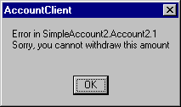
Obtaining Error Information (2)
In a Visual Basic client, provide an error handler
Private Sub Test_Click()
On Error GoTo Errhandler
Dim acc As SIMPLEACCOUNTLib.Account
Set acc = CreateObject("SimpleAccount.Account")
acc.Deposit 1000
acc.Withdraw 10000 ' should cause an error
MsgBox "New balance is " & acc.Balance
Exit Sub
Errhandler:
Dim str As String
str = "Error in " + Err.Source + vbCrLf
str = str + Err.Description + vbCrLf
MsgBox str
End Sub
Notes:
Page <number>
WNCOMPG-2 v1.5
Chapter 9, Language Integration

Slide 21
Summary
Visual Basic clients can use both early and late binding
Scripting-language clients can use only late binding
Visual C++ clients can be simplified by using #import and smart pointers
Error objects allow a non-Automation server to return rich error information to a client
Notes:
Page <number>
WNCOMPG-2 v1.5
Chapter 9, Language Integration

